Slide 1



Slide 2




Let’s recap a bit
We will go through the topics covered in MS Word session
You will share your learnings from the same
Notes:
2

Slide 3

A Quick Recap
Why word processing?
Key learnings:
Understanding the connection between the task & the respective operating path in the ribbon
Figuring out the steps to be taken to perform a task
Opening MS Word
Introduction to Word interface
Saving a document
Entering & Editing – Ruler, Paragraph icon, Spelling & Grammar, Find & Replace, Clipboard
Formatting text – Font, Paragraph, Styles
Page Setup – Margins, Orientation, Breaks
Insert – Pictures, text box, Tables – table manipulation
Notes:
3

Slide 4

Introduction to MS PowerPoint
Notes:
4

Slide 5
Why Presentation Program?
The objective of any exhibition is to make the message understood and remembered by others. An electronic presentation program is created to help us build such exhibitions effectively. It enables us to use pictures/charts/graphics, music or videos to achieve that task.
A commonly used presentation program is Microsoft PowerPoint, although there are alternatives such as OpenOffice.org, Impress, Corel Presentations and Apple's Keynote. We shall cover the most common one among these.
For educational, professional and general communication purposes a presentation is best way to exhibit ideas. Hence, mastering seems to be a modern day necessity.
Notes:
Ask the participants what do they know about PowerPoint and later get into presentation program > PPT – 2 mins
5

Slide 6
What we will cover
Why presentation program
Getting started with PowerPoint – Opening, Interface, Saving
Working with Slides – Layout, Formatting
Entering, editing and formatting text
Adding Graphic elements – Images, Shapes, SmartArt
Slide navigation and Slide View
Slide Show
Printing presentation

Slide 7
Norms for the session
Eyes on the ppt for the instructions
Notice & listen to the instructor while I perform the task
Perform the task in your desktops
My software version might be different than yours. Just keep in mind. Most features are the same.
Takes turns in operating
Raise hands in case of any doubts
If your group is done please patiently wait for other to finish
After performing each task please notice the below
What is the task?
Steps & terminology involved
Connection between the task & the respective operating path in the ribbon

Slide 8
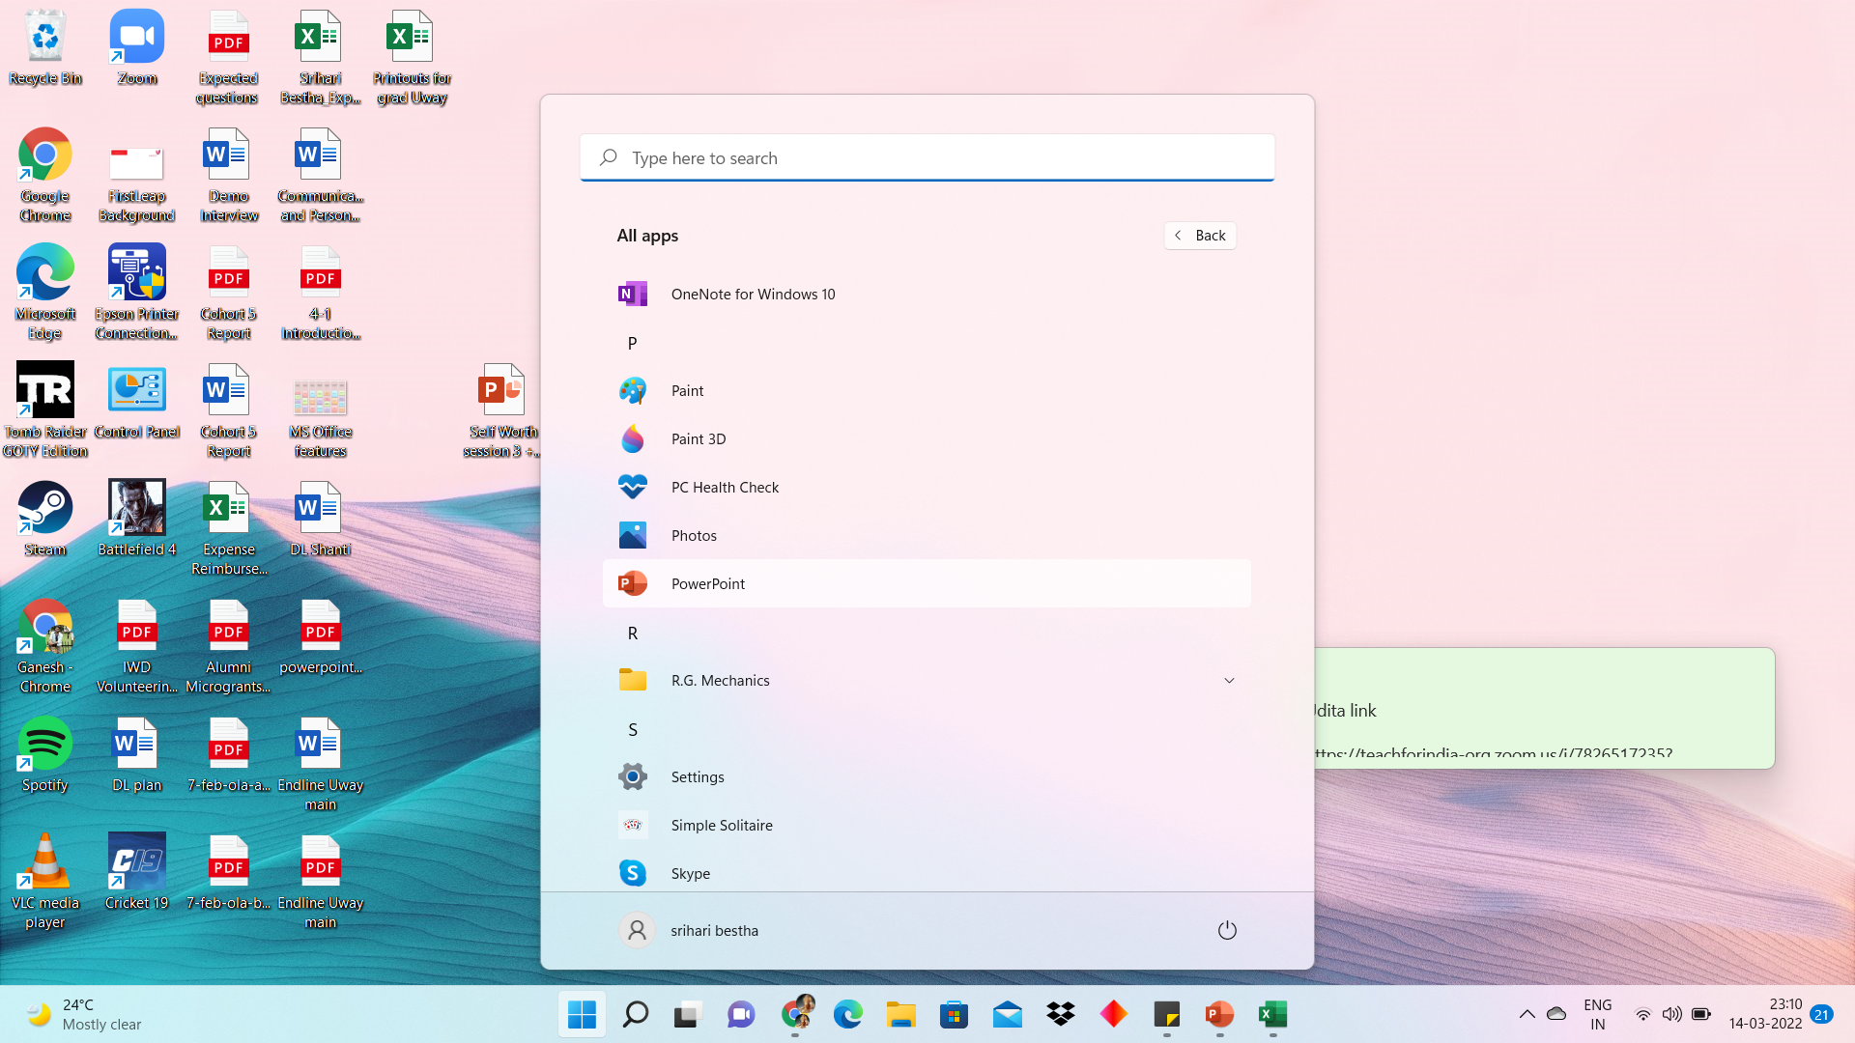
Getting started with PowerPoint
Start > Programs/Apps > PowerPoint > Open > PowerPoint Interface
2
3
1
Notes:
We will create a PPT all along this session while explaining each slide.
8

Slide 9
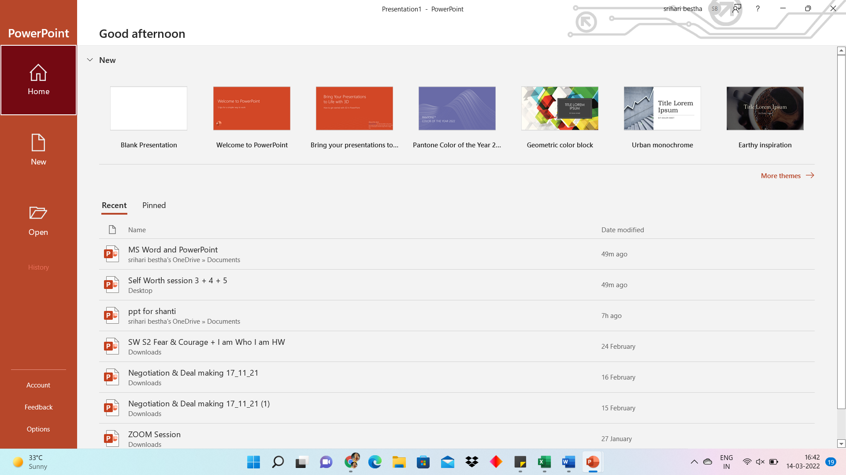
Open PowerPoint > in the left pane, select New > Select an option:
To create a presentation from scratch, select Blank Presentation.
To use a prepared design, select one of the templates.
Notes:
Every participant will open PPT in their systems
9

Slide 10
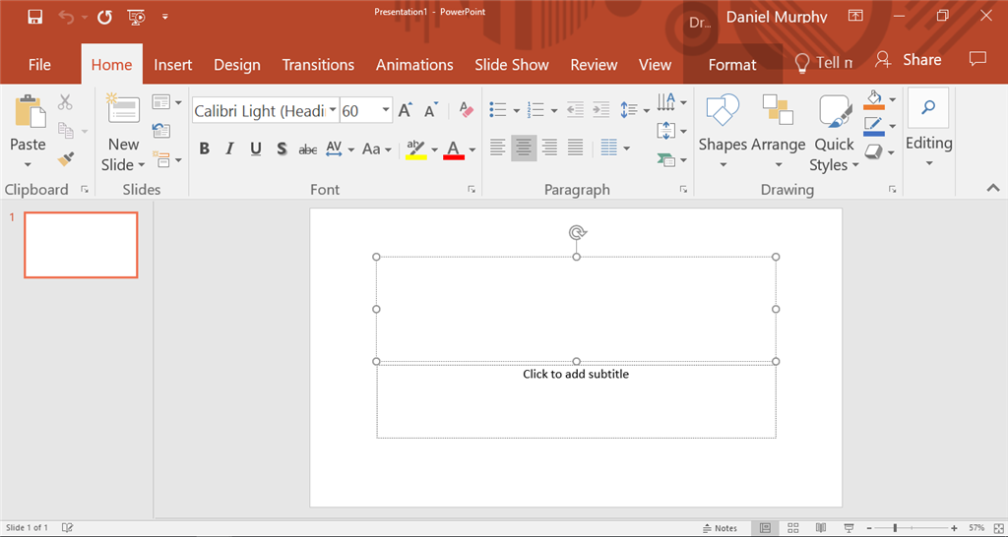
PowerPoint Interface
Notes:
4 mins – describe and introduce terminology. Focus on understanding term and action relation.
10

Slide 11
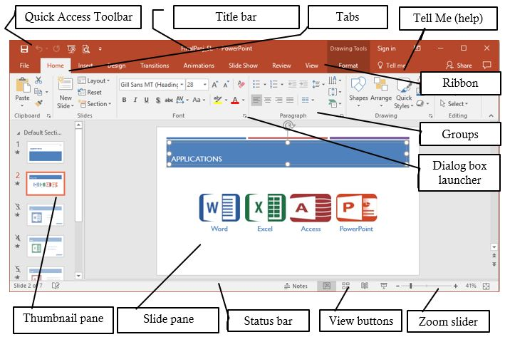

Slide 12
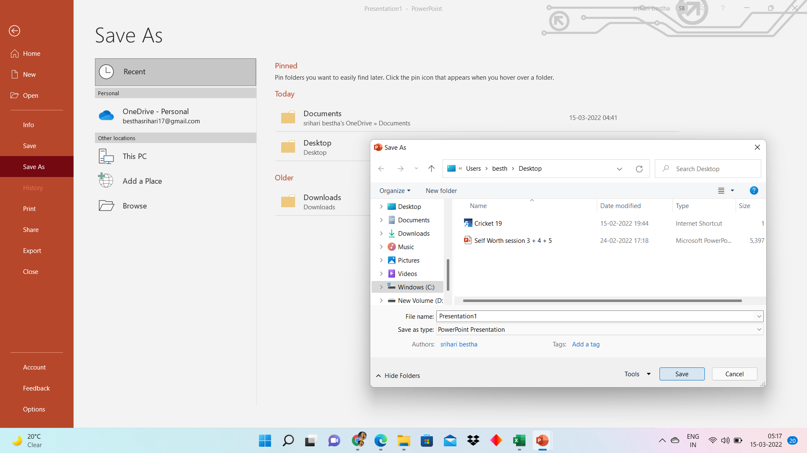
Save the presentation – Save & Save As from File Tab. Save As – To store the current open document with a new name or location. Save – To store the current open document as a file. If the file has not been saved yet, prompts for a filename. Same as Quick Save. Crtl+S. File Extension (basic) - .pptx or .ppt
1
2
3
4

Slide 13
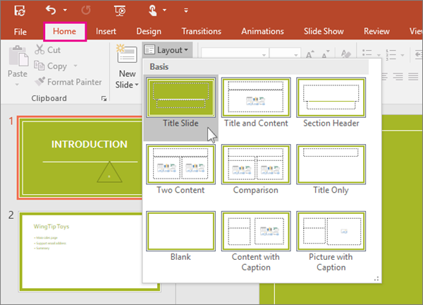
Working with Slides
Slide Layouts:
When creating a new slide > In the Home tab, in the Slides section, select New Slide.
In the Slides section, select Layout, and then select the layout you want from the menu.
1
2
3
Notes:
2 mins + Rule 1 – attention towards Ribbon – Tabs, Groups, and changes
13

Slide 14
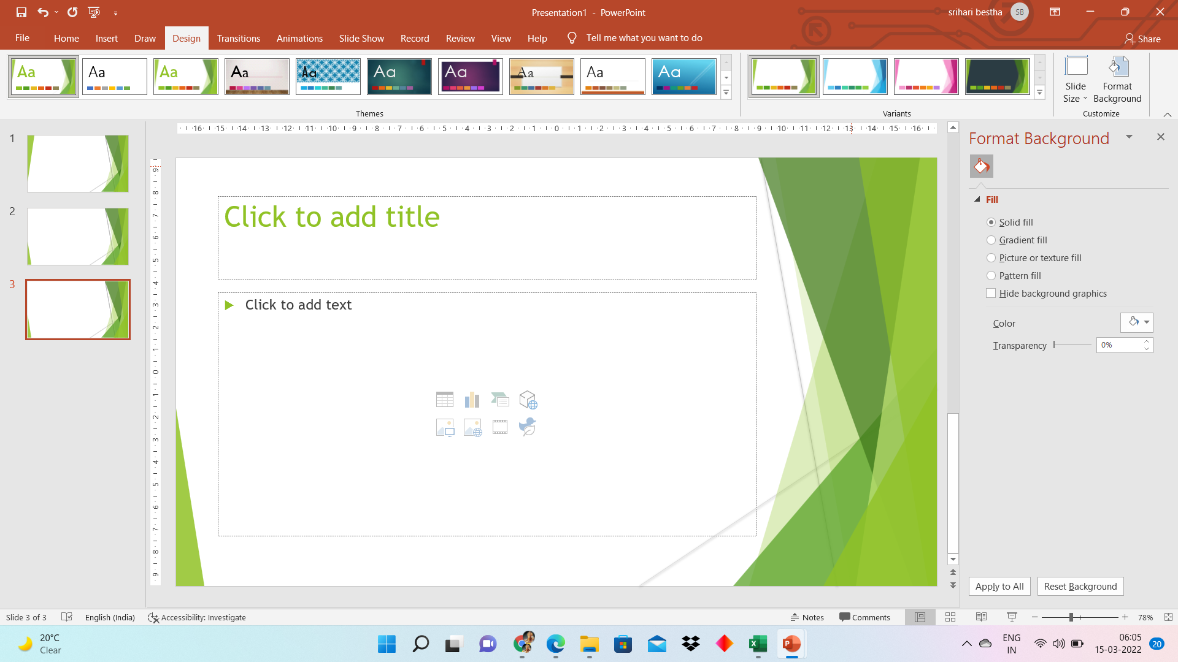
Apply a theme to the slide:
Design Tab
Themes – more themes
Variants
Customize
Slide size
Format Background
1
Notes:
2 mins
14

Slide 15
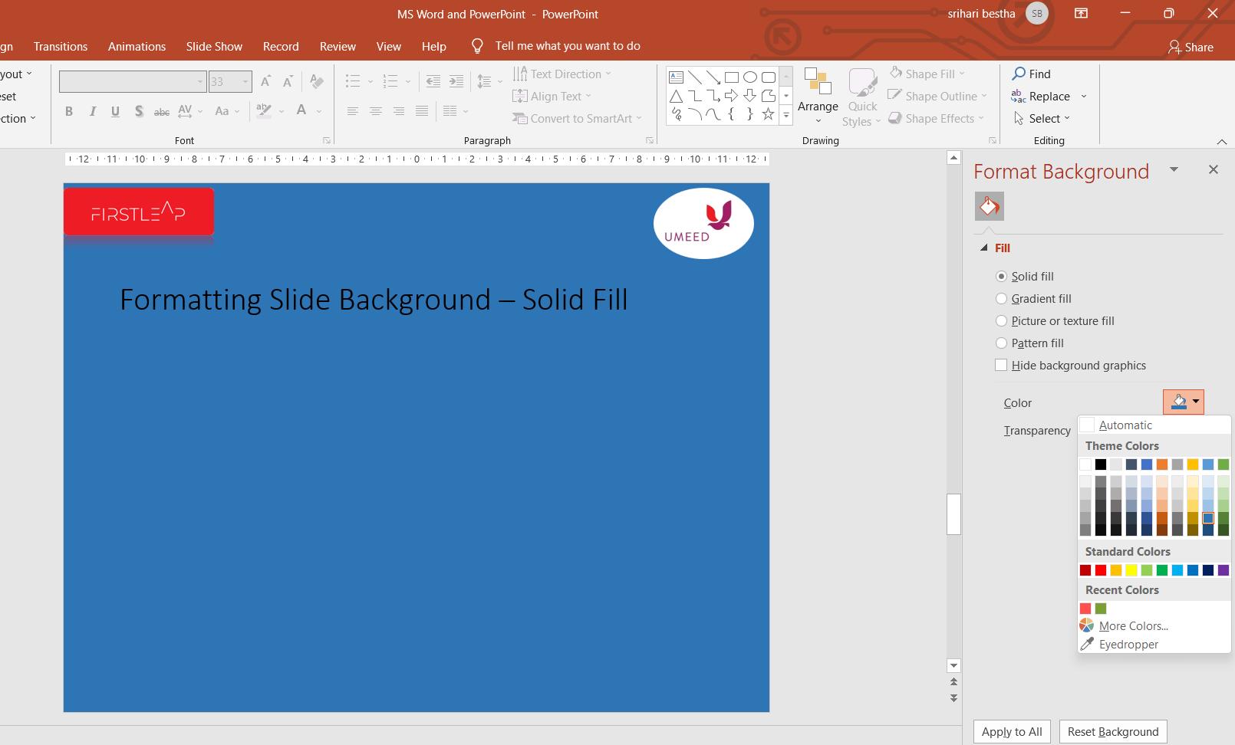
Formatting Slide Background – Solid Fill
1
2
Use Redo and Undo commands
Notes:
2 mins
15

Slide 16

Formatting Slide Background – Gradient fill & Picture or texture fill
Hello World !
Hello World !
Notes:
Slide preparation tasktime – 3 mins
16

Slide 17
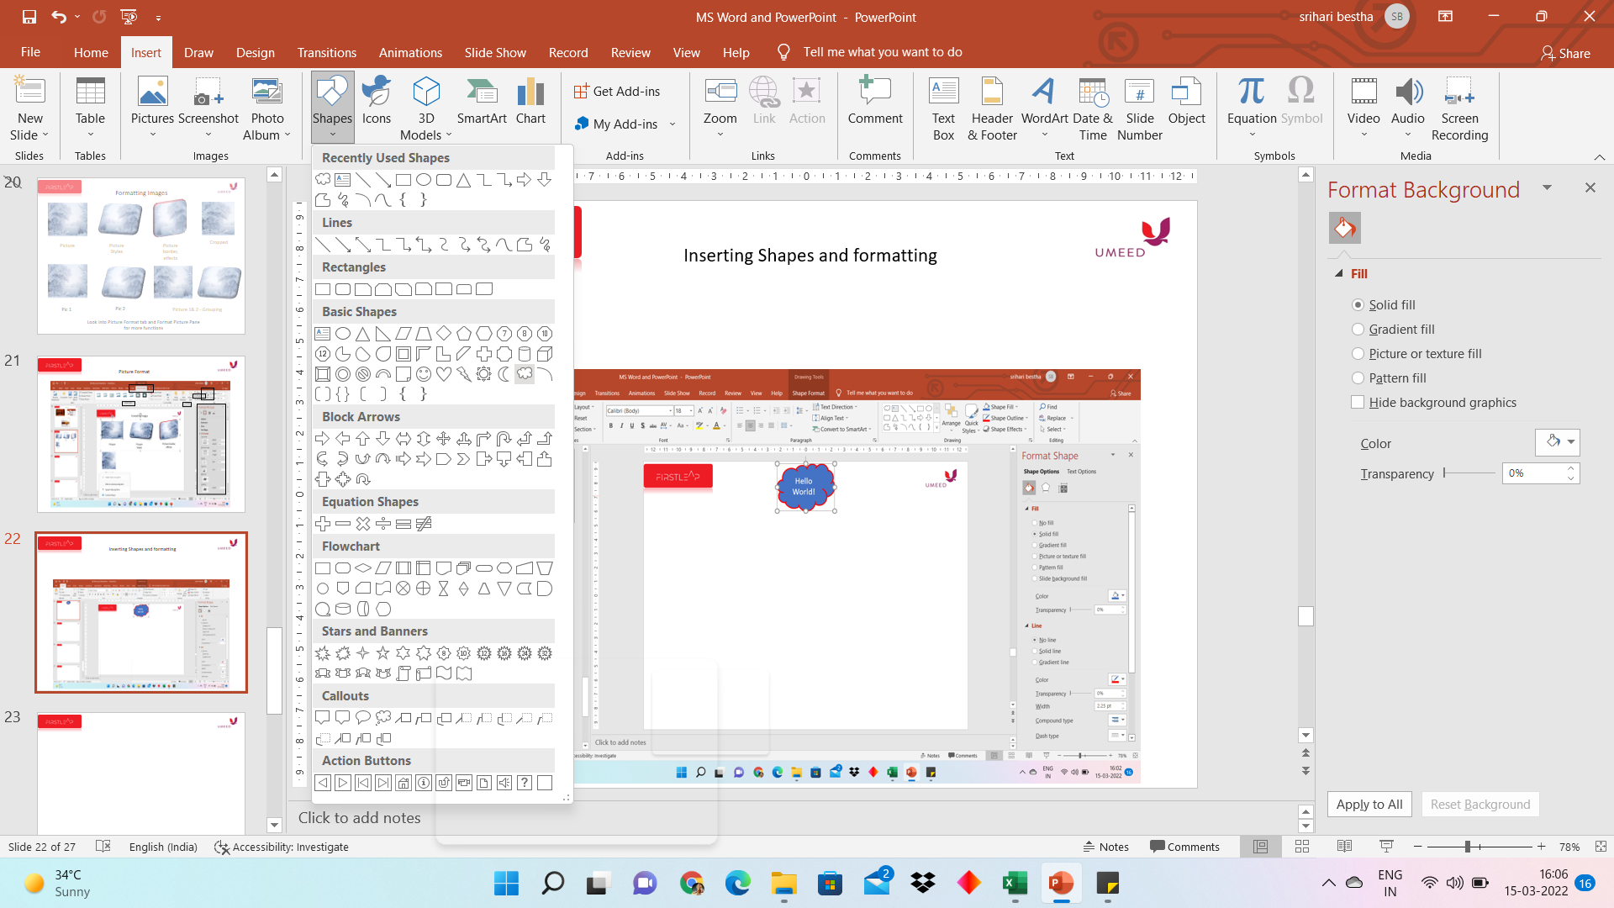
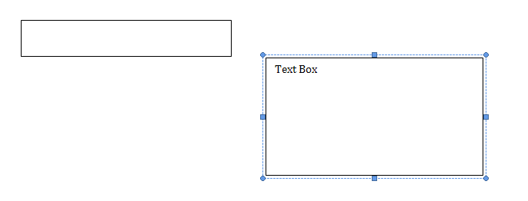
Adding Text Box
Notes:
1 min + notice time 1 min
17

Slide 18
Entering and Editing Text
Edit text - Usage of Spelling and Grammar
Navigate within text – Mouse scroll, cursor positioning, Ctrl+Arrows, Usage of Find, Replace
Selecting text – Click and drag, Shift+arrow > letterwise, Shift+Ctrl+arrow> wordwise, Ctrl+(words independently)
Cut – Ctrl+X, Copy – Ctrl+C, Paste text – Ctrl+V, Clipboard Pane in Home Tab presents all copied data
Notes:
4 mins + notice time 2 mins
Also, involves making participants aware of keyboard keys and how they function.
In practice time, we shall ask the participants to find ‘Autocorrect’ using ‘Help’ tab after introducing Help.
Enter text - @S 1” Π; Shift+Enter – to get text below the line; Tab Key to indent; Usage of Ruler, Autofit Icon
18

Slide 19
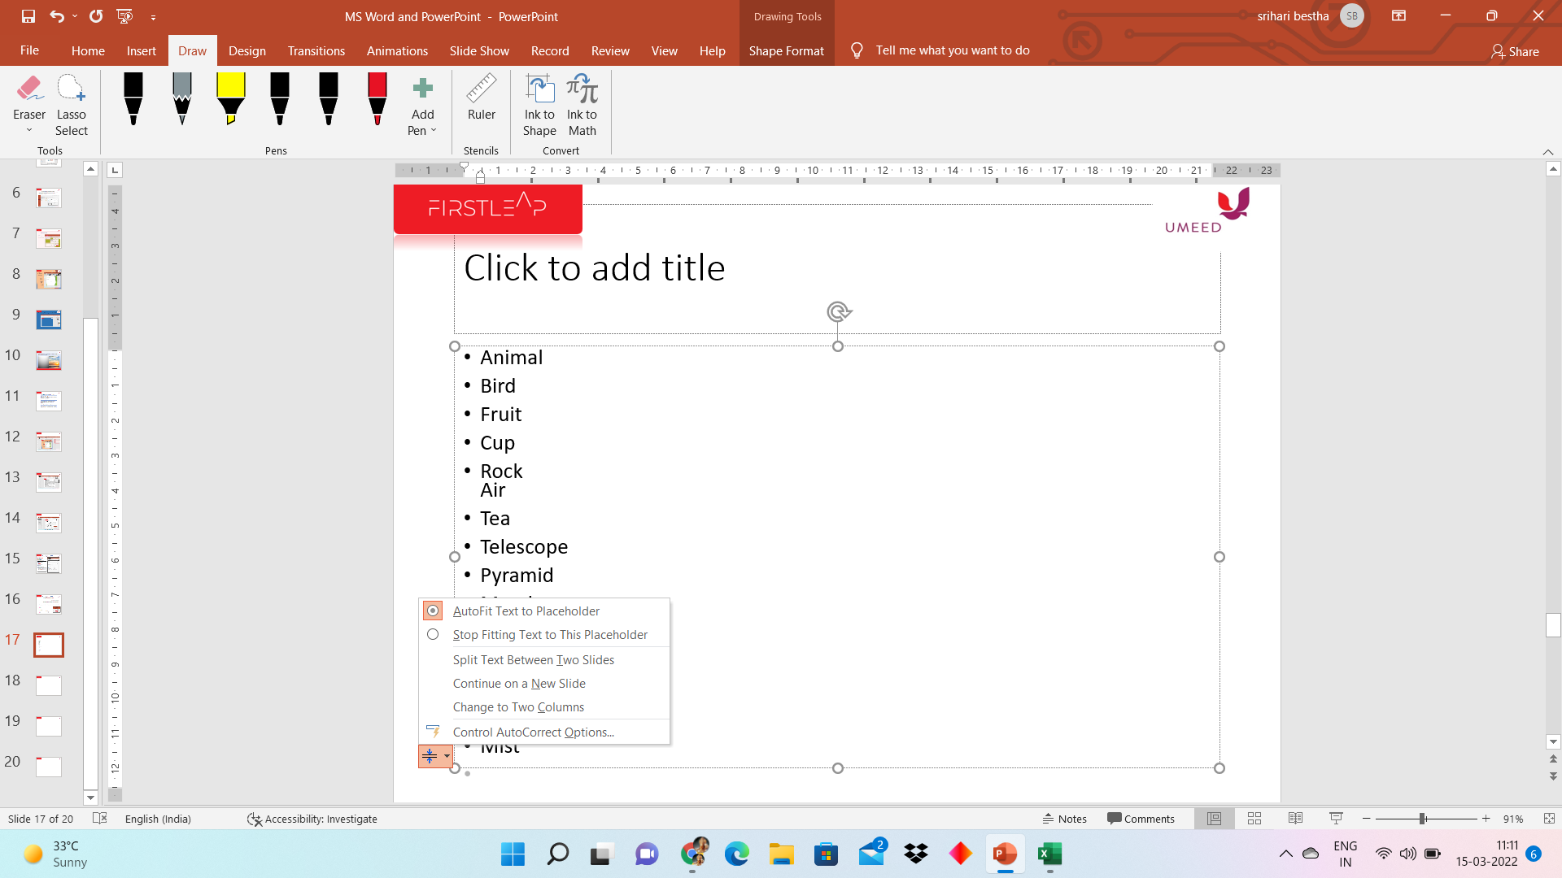
Autofit & Fitting text between slides
2
1
Notes:
1 min + notice time 1 min
19

Slide 20
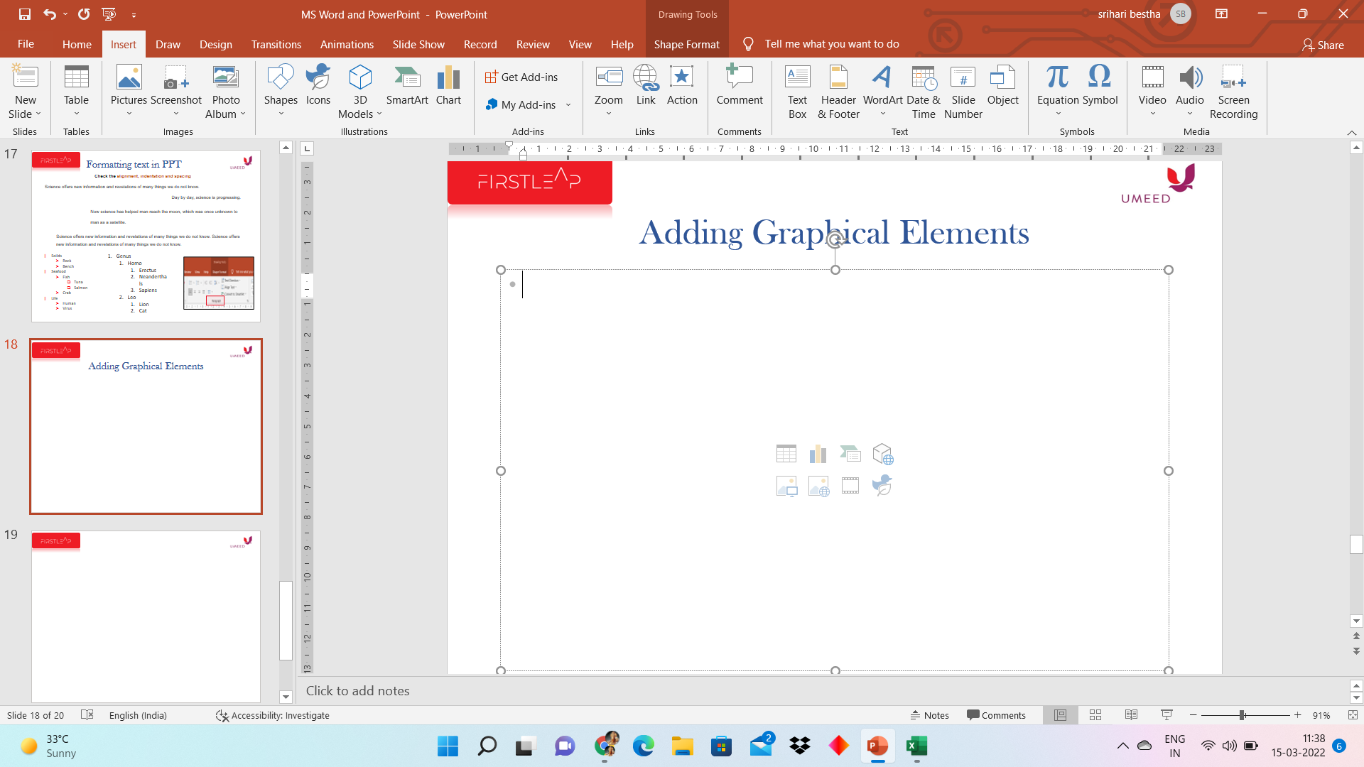
Adding Graphical Elements
Insert options on the content layout of slide
Insert SmartArt Graphics
Insert Tables
Insert Charts
3D Models
Pictures
Online Pictures
Videos
Icons

Slide 21

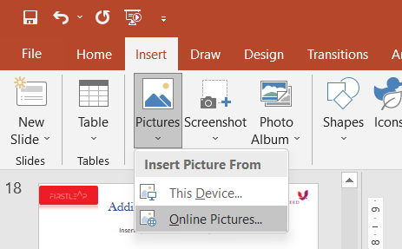
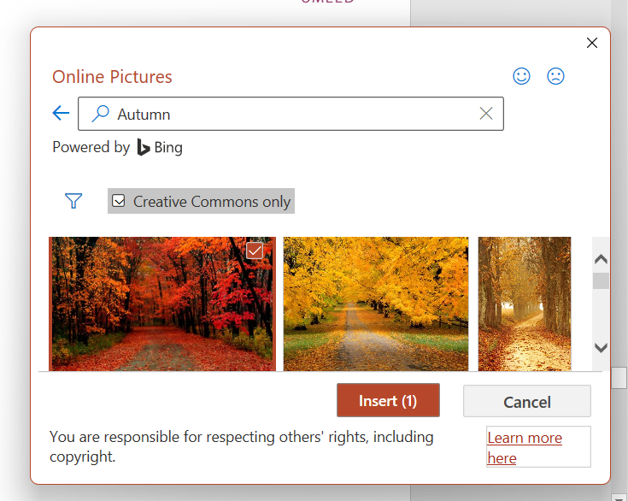
Inserting Images
1
3
2
Notes:
1 min + 0.5 min
21

Slide 22
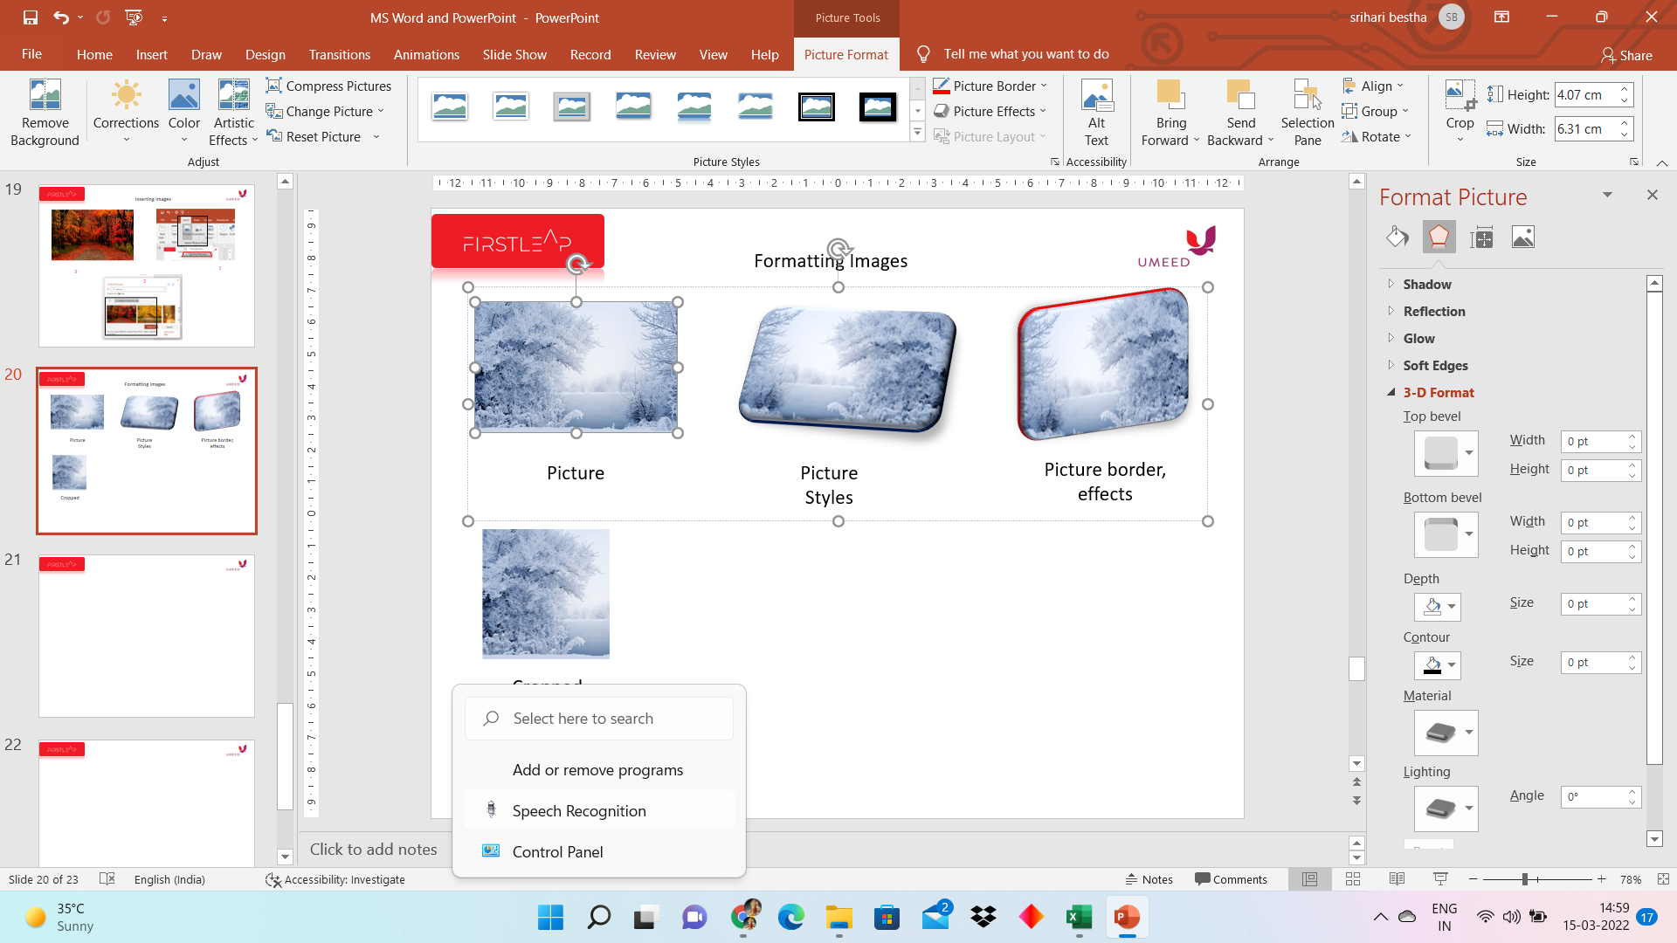
Picture Format
2
2
1
Notes:
4 mins + 2 mins
22

Slide 23
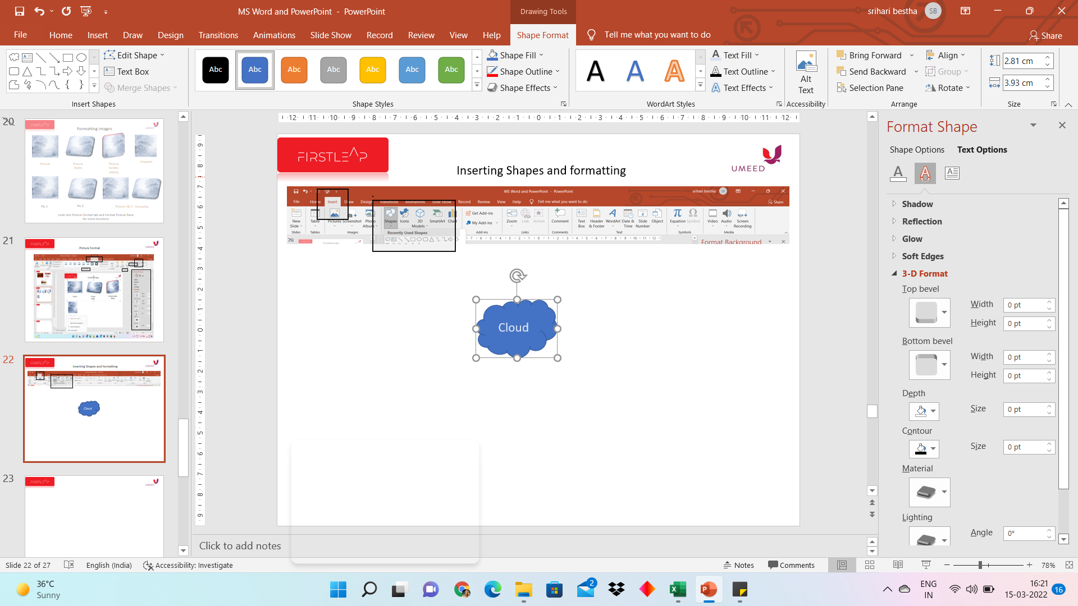
Inserting Shapes and formatting
1
2
3
4
Notes:
23

Slide 24
What we have covered so far...
Why presentation program
Getting started with PowerPoint – Opening, Interface, Saving
Working with Slides – Layout, Formatting
Entering, editing and formatting text
Adding Graphic elements – Images, Shapes

Slide 25
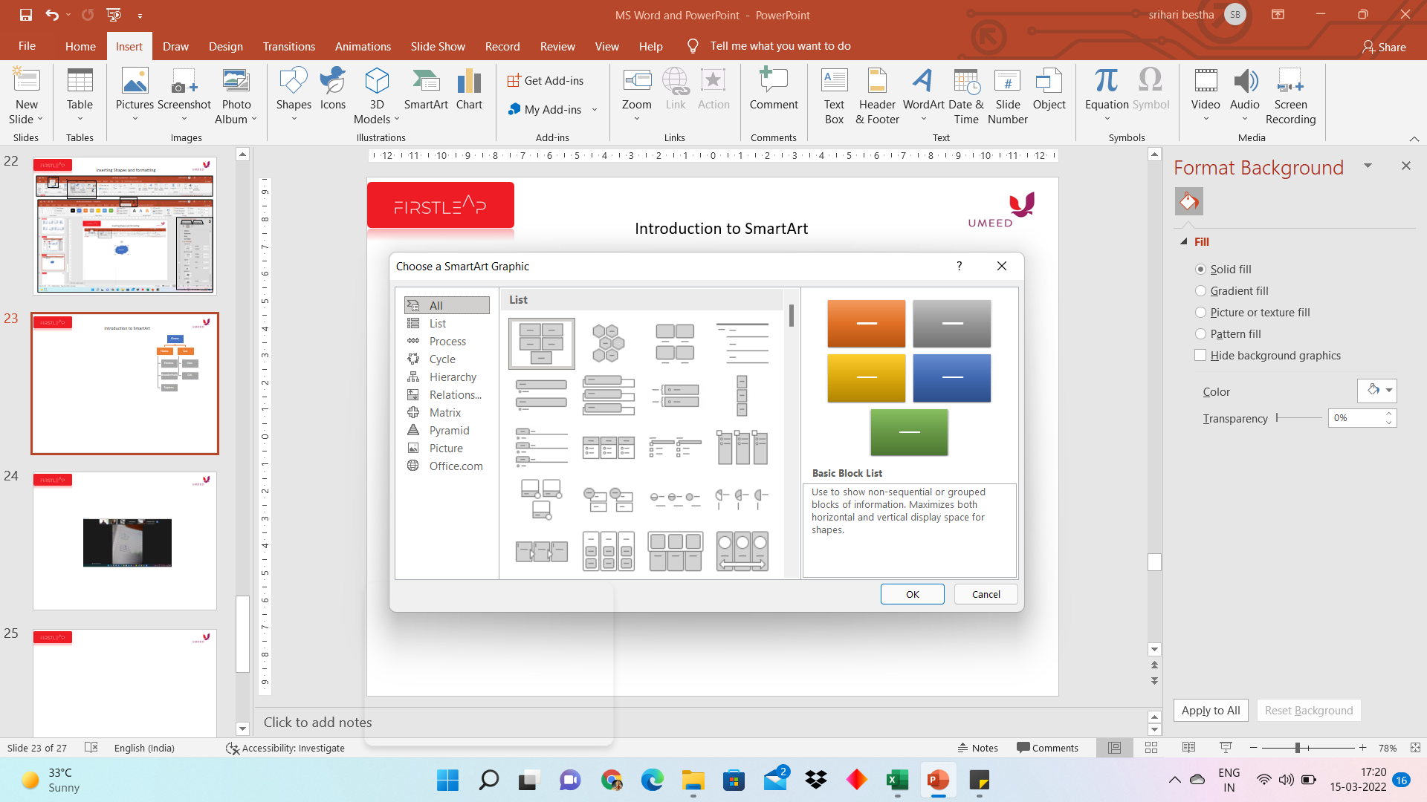
Introduction to SmartArt
1
2
3
Notes:
25

Slide 26
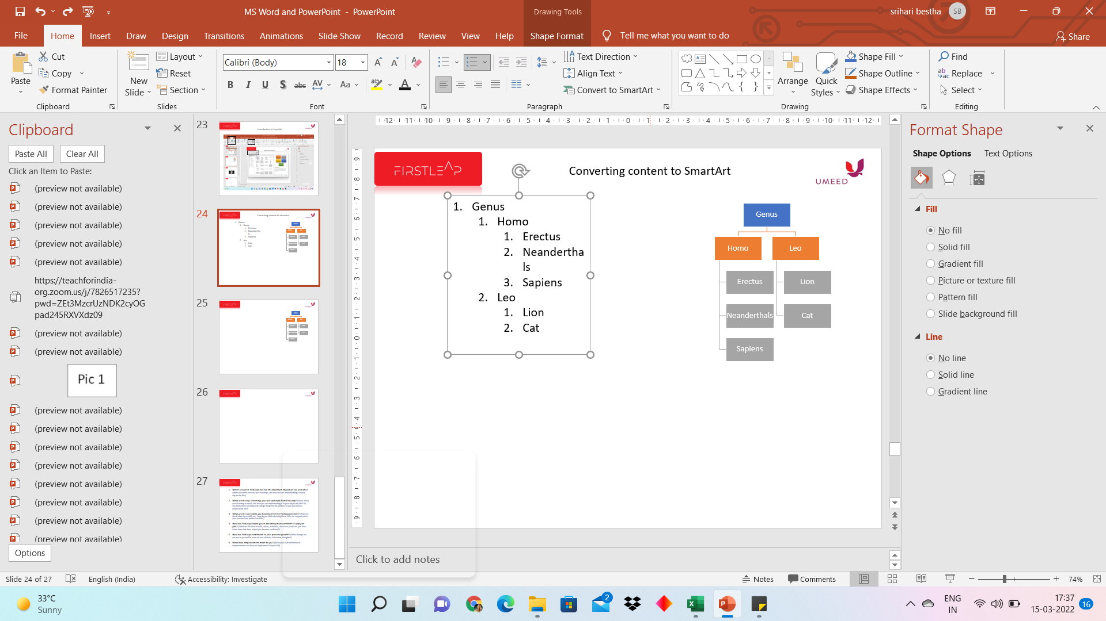
Converting content to SmartArt
1
2
3
Notes:
26

Slide 27
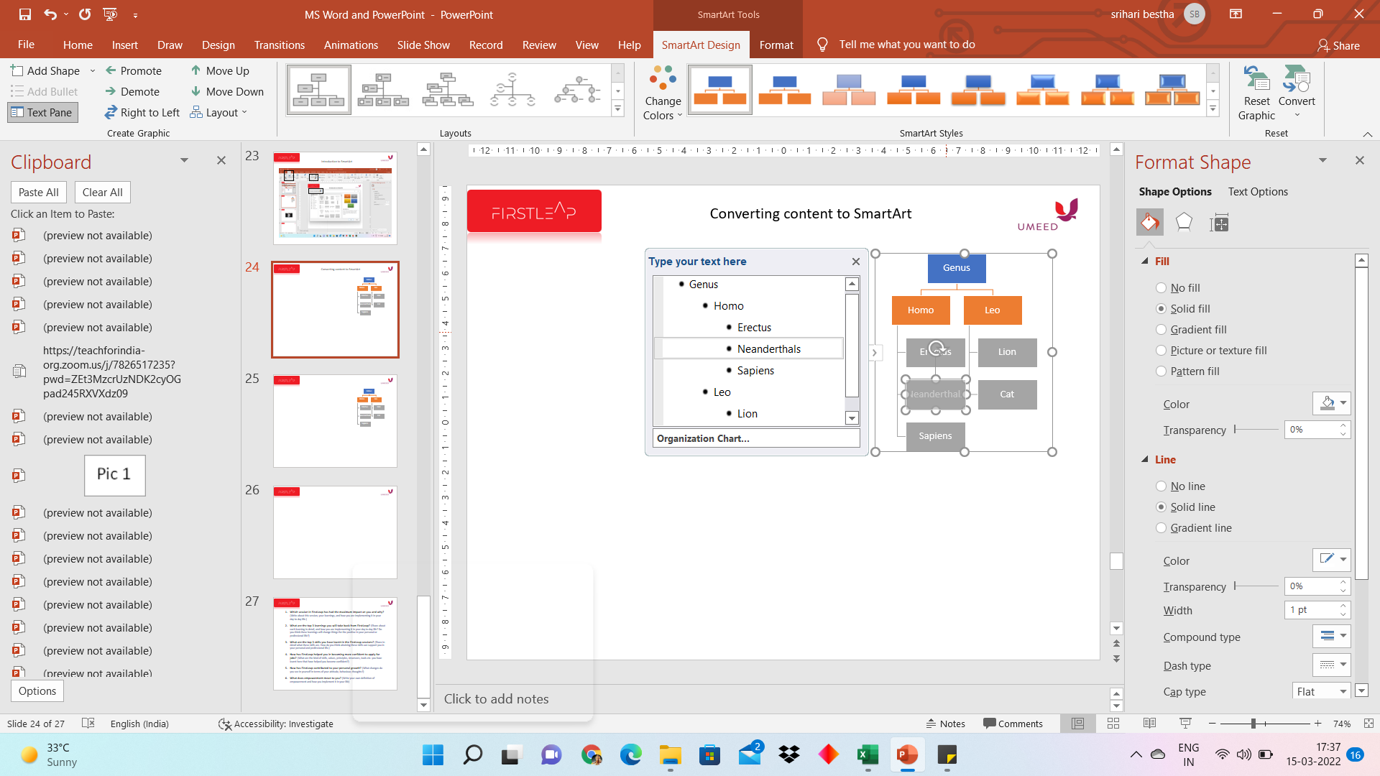
SmartArt Tools – SmartArt Design
Notes:
27

Slide 28
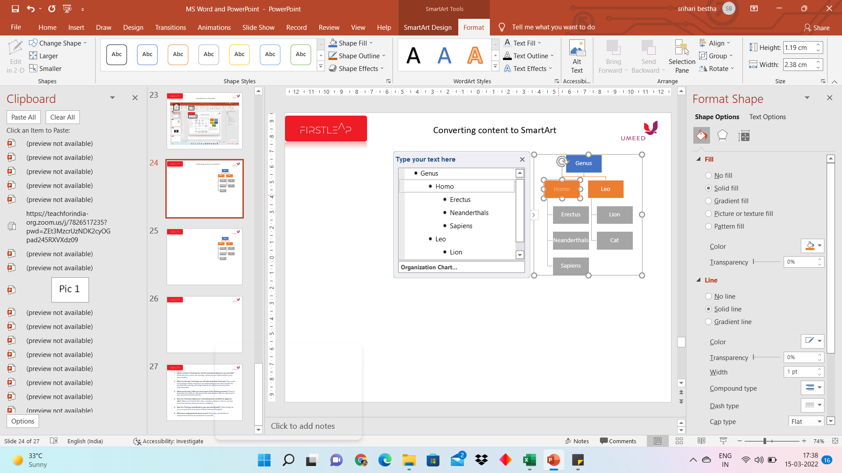
SmartArt Tools - Format
Notes:
28

Slide 29
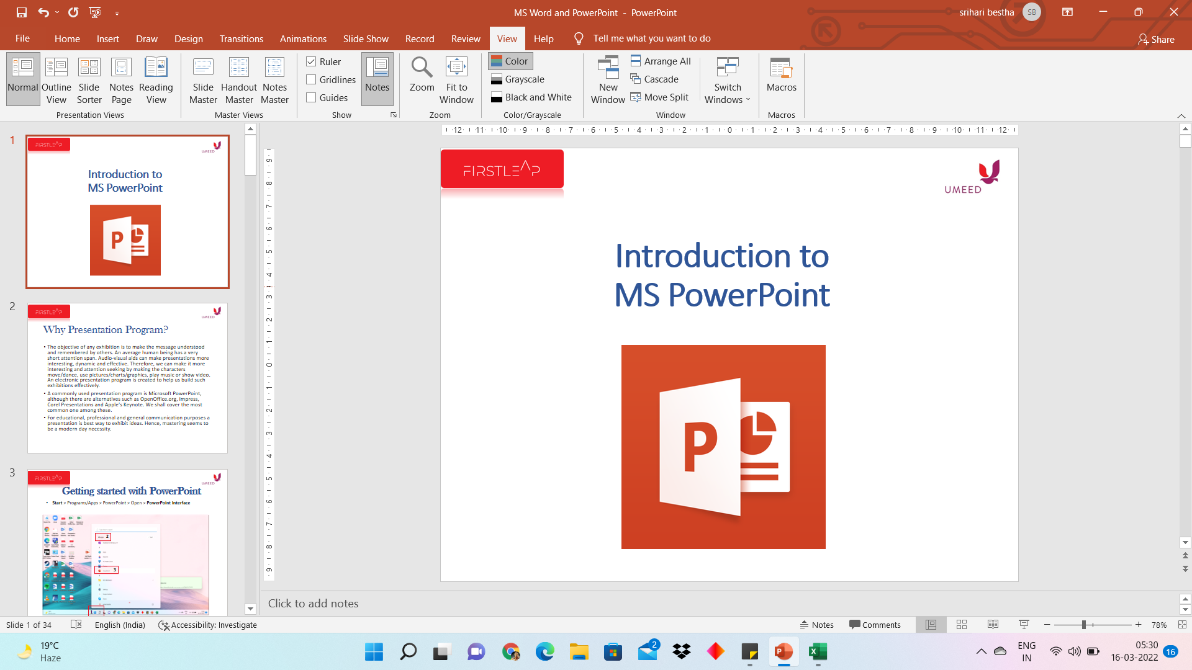
Slide Navigation and Slide View
1
Slide View > View tab & Status bar
Slide Navigation > Navigation side pane & Slide sorter in presentation views
Notes:
29

Slide 30
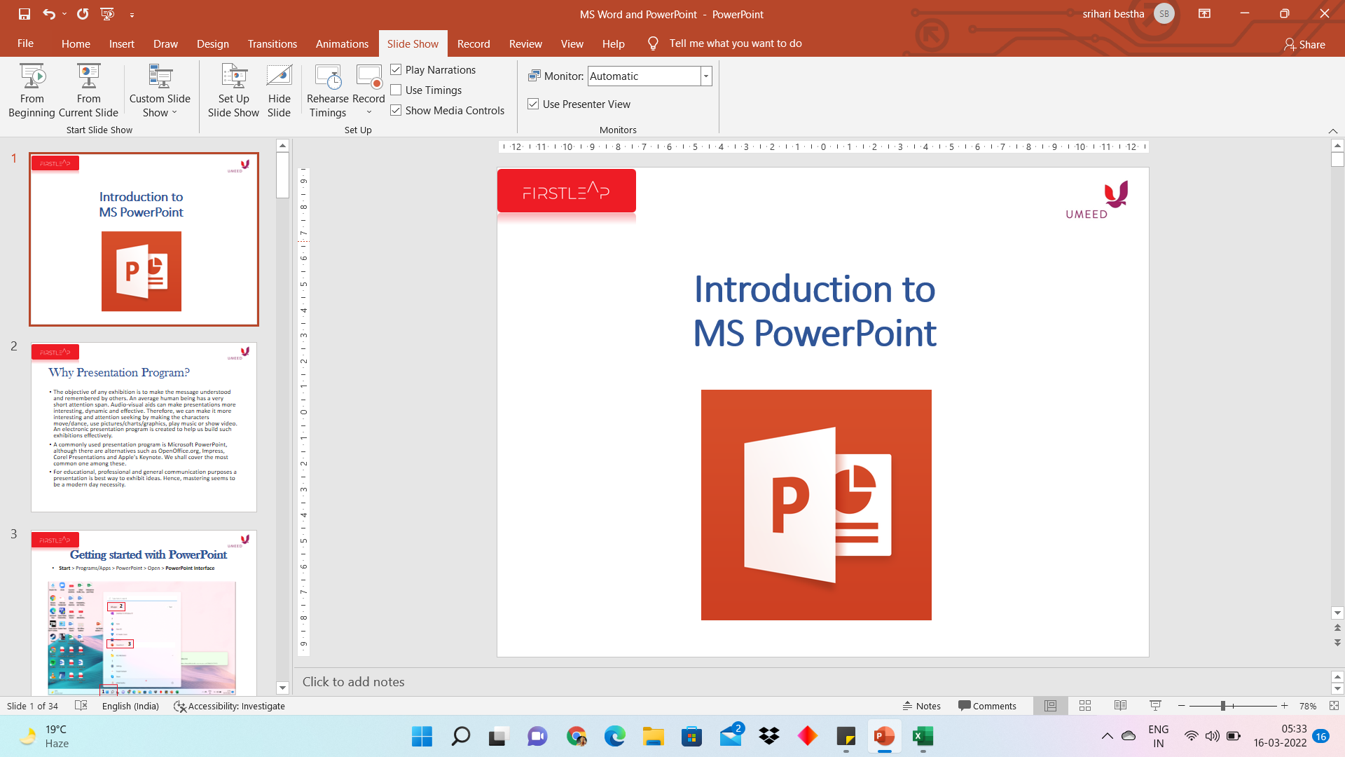
Slide Show
1
Slide Show – F5
Notes:
Powerpoint
30

Slide 31
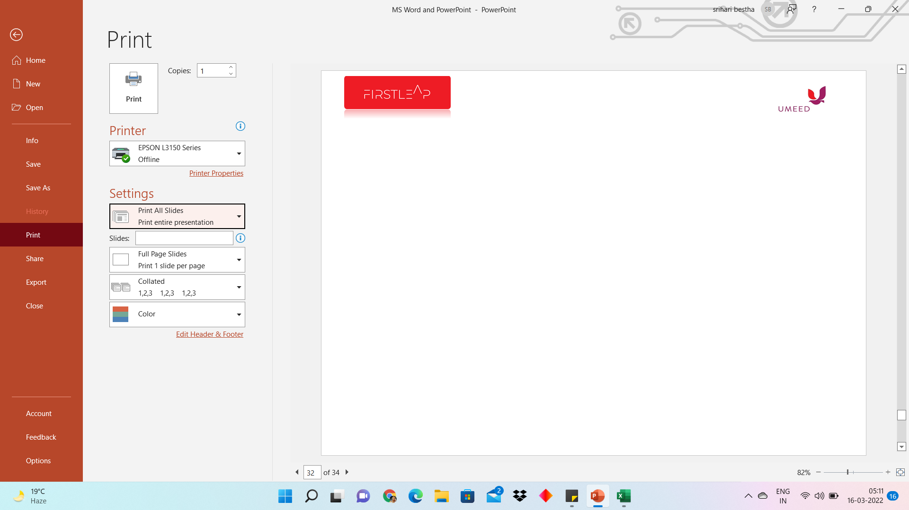
Printing a presentation
File tab > Print – Ctrl + P
Notes:
31

Slide 32
A Quick Recap
Why presentation program
Getting started with PowerPoint – Opening, Interface, Saving
Working with Slides – Layout, Formatting
Entering, editing and formatting text
Adding Graphic elements – Images, Shapes, SmartArt
Slide navigation and Slide View
Slide Show
Printing presentation

Slide 33
Homework
Which session in FirstLeap has had the maximum impact on you and why? (Write about this session, your learnings, and how you are implementing it in your day to day life.)
What are the top 3 learnings you will take back from FirstLeap? (Share about each learning in detail, and how you are implementing it in your day to day life? Do you think these learnings will change things for the positive in your personal or professional life?)
What are the top 3 skills you have learnt in the FirstLeap sessions? (Share in detail what these skills are. How do you think attaining these skills can support you in your personal and professional life.)
How has FirstLeap helped you in becoming more confident to apply for jobs? (What are the kind of skills, values, principles, structures, tools etc. you have learnt here that have helped you become confident?)
How has FirstLeap contributed to your personal growth? (What changes do you see in yourself in terms of your attitude, behaviour, thoughts?)
What does empowerment mean to you? (Write your own definition of empowerment and how you implement it in your life)

